Slide 1


William Hunter Final Report: Week of 7/29
Opportunity Hunter
July 29th, 2019

Slide 2





Introduction to Opportunity Hunter
What did I hope to achieve?
PROJECTS
Increase the number of jobs that our team and other teams are working on to increase revenue for the firm.
ACCESSIBILITY
Automate research and present the team with useful information that they would have searched for.
RFPs
Acquiring RFPs and RFIs from government websites for the team to apply to.
EVENTS
Find events for the team to attend that could help with current projects or future jobs.
July 29, 2019

Slide 3
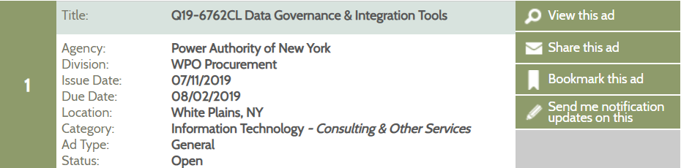
Benefits of the Project
How will this be useful?
Finds opportunities for the team would not have found
Already found an RFP that we are currently looking to apply towards
Daily reminder for all the new jobs that can be applied for.
Easy for the user to understand the report.
July 29, 2019

Slide 4



Information Captured
What specifically is being scraped
RFPs
The tool is first looking for RFPs and RFIs that are posted daily on government websites.
NYSCR.gov
DASNY.org
GOV.uk
RFPDB.com
Events
The tool also looks for possible networking events or events that could be useful to the team to find new jobs or work on current jobs.
EventBrite.com
10Times.com
Information
The information gathered is all from the listings posted on the site, and as much of it as possible. It includes job description, issue date, due date, company, location,
and much more.
July 29, 2019

Slide 5
Overall Process
How is the information scraped?
Scrape all RFP sites using the Python library BeautifulSoup.
Insert this data into a raw SQL table.
Scrape all event sites using their API through python.
Insert this data into a raw SQL table.
Clean the individual tables using SQL queries.
Insert all individual sites into master table and current table.
Using Pandas take SQL queries and insert the data in data frame.
Export the data frames into excel sheets.
Attach the excel sheet and email the team the results using Yagmail and HMTL.
July 29, 2019

Slide 6
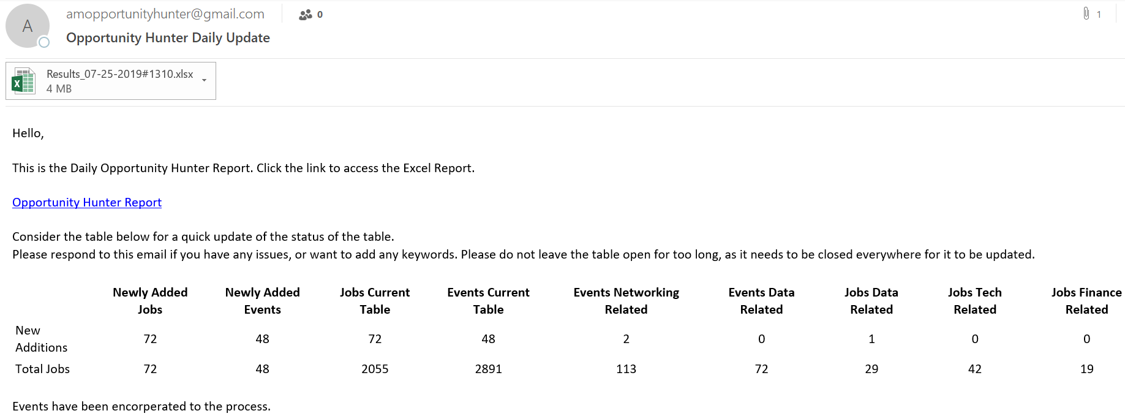
Example Report
Daily Email
July 29, 2019

Slide 7
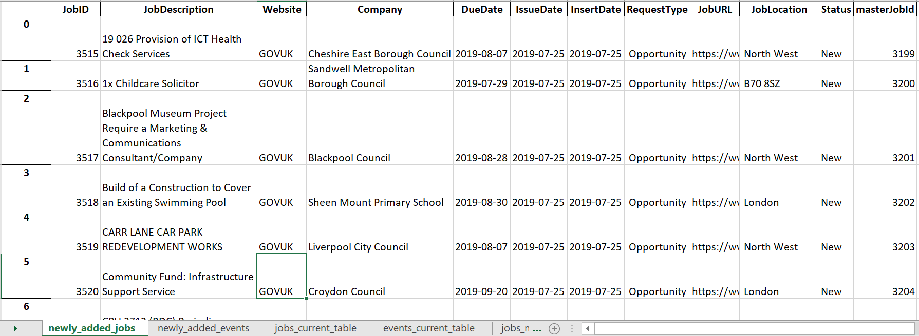
Example of Data Stored
In Excel File
July 29, 2019

Slide 8



Opportunity Hunter Guide
README
Code Walkthrough
Adding a site guide
Troubleshooting Helper
July 29, 2019

Slide 9



Latest Improvements
What I have recently done
Added Eventbrite and events to the system
Renamed the SQL tables and folders so its more logical
Fixed the way strings were interacting in Python
July 29, 2019

Slide 10

Next Steps
What could be improved in the future
Scraping More Sites
There are many more sites to look at, such as FBO.gov.
Formatting/Looks
I would like to auto format the excel sheets and add tables to the email.
Keywords
Use keyword analysis to identify which jobs are useful to our team and other teams.
RFP Applications
Figure out a way to pair previous decks with RFPs to speed up applications.
July 29, 2019

Slide 11
Big Accomplishments
Large Milestones of the Project
Web Scraping
Using APIs
Automatic Emails
Data Manipulation
Automatic Executables
Python Data
Frames
July 29, 2019

Slide 12




What I have learned
Takeaways from the internship
Programming
Through the process I have mastered two new languages and many Python Libraries that are very useful.
Planning a Project
I have learned how to plan out a project step by step and to tackle large code a section at a time.
How to Debug
Through my time with this project, I have encountered various bugs that took the system down, and learned to deal with this effectively.
Working with a Team
This was my first experience working and communicating with a team regarding a project.
July 29, 2019

Slide 13


Back cover
Alvarez & Marsal Holdings, LLC. All rights reserved. ALVAREZ & MARSAL®,
® and A&M® are trademarks of Alvarez & Marsal Holdings, LLC.
© Copyright 2019
0000

